Slide 1

ScrollTherm®
Thermal Treatment Process for
Radioactive Ion Exchange Resins and Hazardous Organic Wastes
CEtech LLC
CEtech LLC Consulting, Engineering, and Technology Development - Patents Pending

Slide 2
Overview
ScrollTherm Process Overview
Ion Exchange Resin (IER) and Organic Waste Treatment
Process Options
Business Opportunities
CEtech LLC ScrollTherm Process – Patents Pending
2

Slide 3
ScrollTherm - Process Inputs, Outputs, and Functions
Process Inputs and Functions: Solutions, Slurries, Wet Cakes, Pastes, and Solids
  Safely and efficiently thermally treats high-activity ion exchange resins (IER), oils, solvents, decontamination solutions, bitumen, tars, sludges, and solids containing alkali metals, nitrates and nitrites, bases (hydroxides), acids, chlorides, fluorides, sulfates, borates, phosphates, plastics, paper, cellulose, clothing, rubber, etc.
  Evaporates water and volatile organic liquids.
  Decomposes non-volatile organics (e.g. IER polymer structure) via non-oxidative pyrolysis.
  Mineralizes alkali metals (Na, K, Li, Cs) to form inert, water insoluble minerals (uses optional additives).
  Retains radionuclides (Cs, Tc, Co, Ni, etc. are not volatile in the ScrollTherm process).
Process Outputs:
  Dry, organic-free, free-flowing, granular, inorganic solids.
  Low-volume process gas stream (steam and VOCs) to offgas treatment system.
CEtech LLC ScrollTherm Process – Patents Pending
3

Slide 4
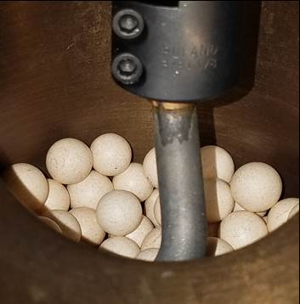
ScrollTherm – Thermal Processing Vessel (STV)
STV vessel: cylindrical pipe inclined at 15 degrees from horizontal.
STV mostly filled with ceramic media balls.
Ceramic media balls are slowly agitated by an internal shaftless scroll (no bearings inside the STV).
External motor/gear drive rotates scroll: 0.2 to 1 RPM
Media: fused alumina balls, 15 to 38 mm diameter.
STV externally heated: up to 650˚C (1202˚F)
  Electrical multi-zone heaters
STV75 Pilot Test Unit
CEtech LLC ScrollTherm Process – Patents Pending
4

Slide 5
Overview – ScrollTherm Process – Ion Exchange Resins
  Purpose of Ion Exchange Resin (IER) treatment
    Separate non-volatile inorganics (including almost all radionuclides) from resin polymer structure via non-oxidative pyrolysis (400 to 550˚C gasification) of resin polymer.
    Volume reduction target: >5x (treated resin residues [RR] <1/5th pretreatment IER volume)
    Prepare treated inorganic resin residues for disposal (no organic content).
  Treatment throughput per ScrollTherm unit (STV): up to 6.8 m³/day (240 cuft/day)
  Stabilization options of treated resin residues - solidification
      Inorganic: geopolymer or hydraulic cement
      Organic: polyethylene or epoxy encapsulation
CEtech LLC ScrollTherm Process – Patents Pending
5

Slide 6
ScrollTherm – Process Features – IER Treatment
Energy efficient
  Moderate temperature process: up to 550˚C (1022˚F).
  Only waste constituents and small nitrogen purge flow are heated to 550˚C.
Environmentally friendly
  All electric during start-up and waste treatment.
  No fossil fuels or organic-based fuels are used.
  Greatly reduced offgas flows and emissions compared to vitrification, fluidized bed steam reforming (FBSR), and incineration.
  Internal-to-STV acid gas adsorption and mineralization of alkali metals by using optional co-reactants
CEtech LLC ScrollTherm Process – Patents Pending
6

Slide 7
ScrollTherm – Process Features – IER Treatment (Cont’d)
Reduced capital, operating, and maintenance costs
  Reduced system complexity - fewer unit operations compared to vitrification, FBSR, and incineration.
  Reduced size and complexity of offgas treatment system:
  Reduced offgas flows and low acid gas content compared with vitrification, FBSR, and incineration.
  No secondary liquid wastes produced for treating most wastes.
  Modular designs reduce construction, shielding, and commissioning costs.
Shielding can be provided for treating high-activity ion exchange resins and other wastes from nuclear facilities with contact dose rates exceeding 6 Gy/hr (600 Rad/hr) while maintaining personnel exposure ALARA.
Robust code compliant systems and equipment (meets ASME, PED, ANSI, ISO and related codes and standards as required for each application).
CEtech LLC ScrollTherm Process – Patents Pending
7

Slide 8
ScrollTherm – Process Features – IER Treatment (cont’d)
Robust operations
  Ability to start-up in 2 to 4 hours (not days) and safely shutdown rapidly.
  Simplified operational controls:
    Waste flow and composition variations are not problematic, and
    Simple temperature control using independent temperature controlled, zoned electrical heaters.
  Full remote operations capable.
  No agglomeration, foaming, or fouling potential.
  STV scroll, vessel internal surfaces, and media are self-cleaning,
  Slow rotation of scroll (0.2 to 1.0 RPM) results in long service life of STV, scroll, and media.
  Long-life, semi-permanent, inert, fused ceramic media balls - no refractories.
  Moderate temperature operations: STV operates at up to 550˚C (1022˚F).
CEtech LLC ScrollTherm Process – Patents Pending
8

Slide 9
Overview – Pyrolysis of Ion Exchange Resins
CEtech LLC ScrollTherm Process – Patents Pending
9

Slide 10
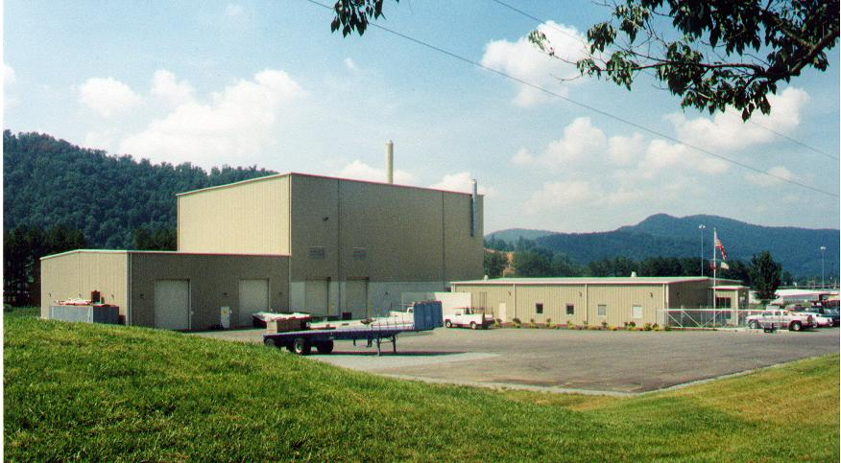
ScrollTherm – Process Deployment Options
Mobile / Transportable Modular Systems
Continuous processing system: two modules, ships by truck in two ISO containers between treatment sites:
Ion exchange resins: up to 1.4 m³ (50 cuft) per day
Water-based, nitrate-based, or organic solutions or slurries: up to 3.7 L/min (1.0 gpm)
Continuous processing system: three custom truck transportable modules:
Ion exchange resins: up to 6.8 m³ (240 cuft) per day
Water-based, nitrate-based, or organic solutions or slurries: up to 22 L/min (6.0 gpm)
STV350 Modular Resin
Fixed-Base Central Facilities - per processing train
Ion exchange resins: up to 6.8 m³ (240 cuft) per day
Water-based, nitrate-based, or organic solutions/slurries: up to 22 L/min (6.0 gpm)
Fixed-Base: Similar to ResinSolutions Erwin, TN
10
CEtech LLC ScrollTherm Process – Patents Pending

Slide 11
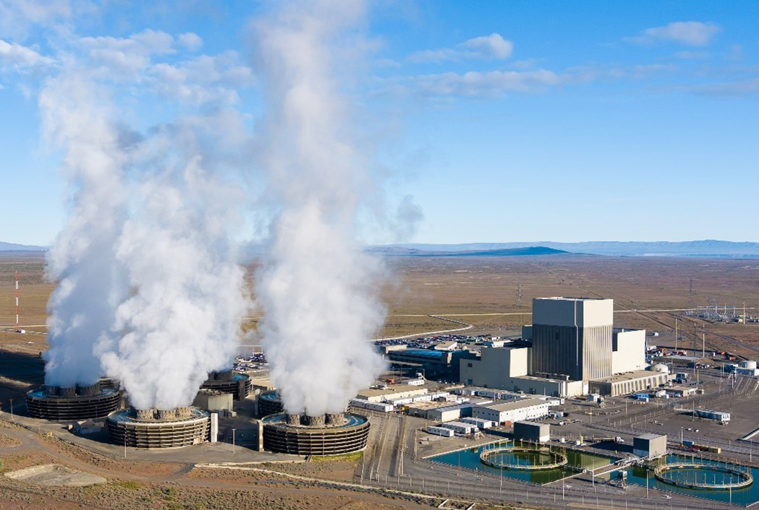
ScrollTherm - Ion Exchange Resin Treatment
Spent (depleted) IER from nuclear power stations are normally stored on-site in large shielded tanks as settled resins with interstitial water or as dewatered resins stored in HICs in storage area.
IER can be treated at several generators’ sites using single transportable modular ScrollTherm system.
Alternatively, IER can be shipped to a fixed-base facility for centralized treatment.
Heavy shielding is normally required as spent high-activity IER from nuclear power stations often have contact dose rates exceeding 4 Gy/h (400 Rad/hr).
Energy Northwest
CEtech LLC ScrollTherm Process – Patents Pending
11

Slide 12
ScrollTherm - IER Treatment - Process Flow Diagram
Specifications:
Throughput IER: Up to 6.8m³/day (240 cuft/day)
All electric, no organic fuels used
Transportable or Fixed-Base
Simple, automated controls
Robust safety features
Low offgas flows
No secondary liquid wastes
CEtech LLC ScrollTherm Process – Patents Pending
12

Slide 13
ScrollTherm Module - IER Treatment Process
Process Equipment | Functions
Resin Slurry Tank (TRS) | Receive cation (SAC) and anion (SBA) resin slurry transfers from facility. Optional: Decant excess slurry water from settled resins.
Slurry Water Tank (TSW) | Receive slurry water removed from TRS and return to facility for reuse.
Liquid Waste Tank (TLW) | Receive liquid wastes from facility (oils, solvents, decon solutions, etc.)
Resin Dewatering Unit (RDU) | Optional: Remove interstitial water from settled resins thereby reducing energy required in STV and increasing overall resin thermal treatment throughput.
Dewatered Resin Feeder (RDF) | Optional: Meter dewatered resins into STV.
Slurry Feed Pump (PSF) | Transfer and meter resin/water slurry or liquid waste into STV.
ScrollTherm Thermal Treatment Vessel (STV) | Evaporate all water from resins and pyrolyze resin polymer structure producing low-volume process gas stream comprising VOCs with evaporated water. Thermally treated resin residue (RR) particles are transferred by the process gas to the Barrier Filter.
Barrier Filter (FDB) | Separate RR particles from process gas. Transfer volume-reduced, organic-free RR solids to packaging system for solidification and subsequent disposal.
CEtech LLC ScrollTherm Process – Patents Pending
13

Slide 14
Process Gas/Offgas Treatment Module – IER Treatment
Process Equipment | Functions
Thermal Oxidizer (ETO) | Oxidize VOCs, NH3, and CO to N2, CO2 and water vapor. Temperature maintained by control of air input temperature and air flow rate (electrically heated air, HA1). No fossil-fuels used.
Quencher Scrubber (TQS) | Cool offgas and absorb acid gases (SOx, Cl, F) from offgas, pH adjusted with NaOH.
QS Cooler (HQS) | Cool scrubber solution by removing heat adsorbed from offgas.
QS Pump (PQS) | Recirculate pH adjusted scrubber solution, transfer salt solution for dispositioning.
Demister (DMST) | Remove entrained mist from water saturated offgas.
Air Heater (HA2) | Heat ventilation air input to maintain combined ventilation air and offgas stream above water vapor condensation temperature.
HEPA Filter | Remove any residual particles in combined ventilation air / offgas stream.
Ventilation Fan (BVN) | Maintain HEPA filters and entire upstream process system under negative pressure (vacuum) and transfer ventilation air/offgas stream to stack or to facility ventilation handling system.
Stack | Discharge ventilation air/offgas to atmosphere, monitor radiological and acid gas emissions.
Resin Residue Packaging | Receive RR from FDB and solidify RR solids inside disposal package.
14
CEtech LLC ScrollTherm Process – Patents Pending

Slide 15
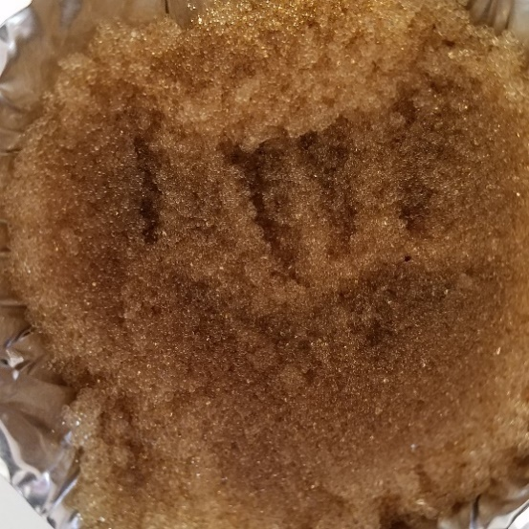
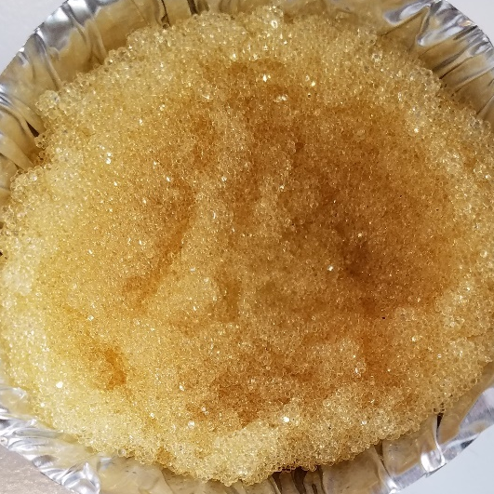
ScrollTherm - IER Treatment Process Operations - 1
Resin is slurry transferred from facility into Resin Slurry Receiver Tank (TRS).
Meter IER into STV for thermal treatment – 3 options:
  Option 1: Feed IER with all interstitial and slurry transfer water into STV
    No water is removed. No water is returned to facility. PSF meters resin slurry into STV.
  Option 2: Remove slurry transfer water then feed IER into STV
    Decant slurry transfer water from above settled IER in TRS. Then using Slurry Feed Pump (PSF), meter resins with interstitial water from TRS into STV.
  Option 3: Fully dewater IER then meter IER into STV
    Transfer resins/water from TRS to Resin Dewatering Unit (RDU) and remove slurry transfer and interstitial water from resins.
    Transfer fully dewatered resins into Dewatered Resin Feeder (RDF) that meters dewatered resins into STV. Dewatered resins contain 52 to 55 wt% internal water.
STV Operations
  All water is evaporated from the IER feed (Option 1, 2, and 3) as the resin particles contact the hot media inside the STV.
  Dried resin particles are heated by the hot media balls.
SAC Resin
SBA Resin
CEtech LLC ScrollTherm Process – Patents Pending
15

Slide 16
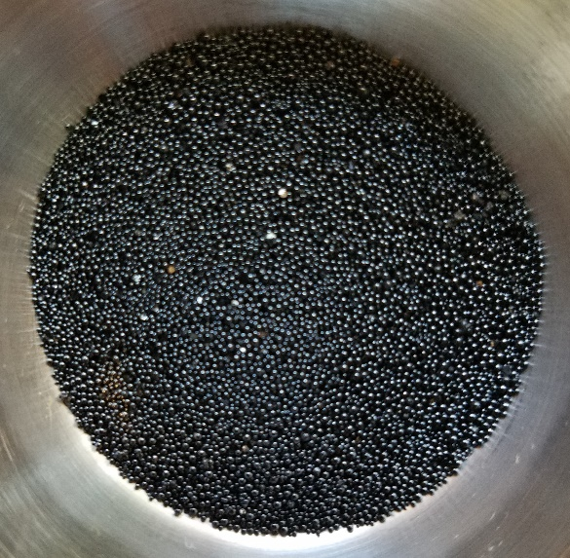
ScrollTherm - IER Treatment Process Operations - 2
STV Operations – Continued
  Thermal decomposition of the resin polymer structure occurs as resins heat-up:
    Strong base anion (SBA) resins: >140˚C (284˚F, Note 1)
    Strong acid cation (SAC) resins: >200˚C (392˚F)
  All organics (including resin polymer) are pyrolyzed (volatized): >450˚C (842˚F)
  Evolved process gases (steam and VOCs) are near theoretical minimum flows.
  Process gas and resin residues (RR) are discharged from the STV bottom outlet nozzle and flow to the Barrier Filter (FDB).
Dry, pyrolyzed, organic-free RR particles are separated from the process gas in the FDB that contains very high-efficiency ceramic fiber filter elements with near HEPA quality particulate removal efficiency (>99.99% removal efficiency for RR particles). RR particles collect in the bottom of the FDB. Filtered process gases flow to the process gas/offgas treatment system.
RR solids are periodically transferred to the packaging or solidification system where the organic-free, volume-reduced, granular/powdered, radioactive solids are prepared for long-term storage or disposal.
Resin Residues
Note 1: SBA resins may start to volatize trimethylamine group [N(CH3)3] at >140˚C
CEtech LLC ScrollTherm Process – Patents Pending
16

Slide 17
ScrollTherm - IER Treatment Process Operations - 3
Process Gas / Offgas Treatment Module Operations
  Process gas from the STV/FDB flows into the Thermal Oxidizer (ETO) where the VOCs, carbon monoxide, and traces of ammonia are oxidized to carbon dioxide, nitrogen, and water vapor. Air Heater (HA1) provides required air input and automatically adjusts air input temperature as needed to maintain ETO at normal operating temperature of 900 to 1000°C (1652 to 1832°F).
  Offgas from the ETO enters the Quencher Scrubber (TQS) where the hot gases are instantly cooled to <100˚C (212˚F). Simultaneously, acid gases in the offgas (primarily SOx from the SO3⁻ groups on the SAC resins) are absorbed from the offgas by the pH controlled TQS solution.
  NaOH solution is added to the TQS solution to maintain scrubber solution pH between 6.8 and 7.5.
  The scrubbed and cooled offgas flows to the Demister (DMST) where any mist or water droplets are removed.
  Downstream of the DMST a controlled flow of ventilation air from the modules is heated by Air Heater (HA2). Heated air commingles with the offgas stream to maintain the offgas above the saturation temperature to prevent water condensation in the offgas line and HEPA filters.
  HEPA filters remove any traces of particulate in the offgas. The HEPA filters and the upstream process systems are maintained under a negative pressure (vacuum) by the Ventilation Fan (BVN). The filtered ventilation air/offgas stream is then monitored for radioactive particles (by the Rad Monitor) and regulated acid gases, CO2, and carbon monoxide (by the CEMS) prior to being discharged to the atmosphere through the stack.
CEtech LLC ScrollTherm Process – Patents Pending
17

Slide 18
ScrollTherm - IER Treatment Benefits
ScrollTherm treatment of resins produces significant volume and weight reductions:
  Weight reductions: SAC: up to 75% SBA: up to 90%
  Volume reductions: SAC: up to 90% SBA: up to 95%
Organics, including the resin polymer structure (polystyrene or polyacrylate), are volatized via non-oxidative pyrolysis producing dry, organic-free, inorganic, particulate resin residue (RR) particles containing essentially all radionuclides on the resins (Cs, Tc, Ni, Fe, Mn, etc.)
Iodine (I¹²⁹), chlorine (Cl³⁶), and carbon (C¹⁴) may be partially or completely volatized from the IER and RR solids by adjusting process operating parameters. Tritium as ³H2O is completely volatized.
Optional: Co-Reactant and Adsorbent Additives:
  Alkali metals (Na, K, Li, and Cs) may be mineralized by co-reactant addition into STV (see next slide).
  Acid gases may be substantially removed from the process gas inside the STV media bed by co-reactant / adsorbent addition into the STV.
18
CEtech LLC ScrollTherm Process – Patents Pending

Slide 19
Cations and Anions on Resins | Mineral Form in STV Resin Residues (RR) | Water Solubility | Co-Reactant Additive Input to STV
Li, Na, K | Li₂CO₃ Na₂CO₃ K₂CO₃ | Li₂CO₃ Slightly Soluble Na₂CO₃ Soluble K₂CO₃ Soluble | None: Li, Na, and K on IER combine with CO₂ in the STV if borates, aluminates, or alumino-silicates are not present.
 | LiAlO₂ NaAlO₂ KAlO₂ | LiAlO₂- Not Soluble NaAlO₂ Soluble KAlO₂ Soluble | Al(OH)₃
 | Li₂B₄O₇ Na₂B₄O₇ K₂B₄O₇ | Soluble | None: Li, Na, and K on cation resins and BO₃ on anion resins may combine to form Li₂B₄O₇, Na₂B₄O₇, and/or K₂B₄O₇ unless Al(OH)₃ or clay is added to STV. See Note 1.
 | Li₂O-Al₂O₃-2SiO₂ Na₂O-Al₂O₃-2SiO₂ Ki₂O-Al₂O₃-2SiO₂ | Not Soluble | Clay
Fe, Ni, Cr, Mn, Mg | Spinel Crystals | Most Spinels are Not Soluble | Metals generally form insoluble, crystalline spinels or stable metal oxides without additives.
Si | SiO₂ | Not Soluble | None
 | Al₂O₃-2SiO₂ | Not Soluble | Al(OH)₃
Ca | CaSO₄ | Not Soluble | Ca on resin and/or addition of Ca(OH)₂ acid gas co-reactant into the STV will bind with SOx from sulfonic group on cation resins to form CaSO₄ solids in the STV that may significantly increase the RR volume while greatly reducing scrubber absorbed sulfate salts (secondary LLW).
B or BO₃ | AlBO₂ | Not Soluble | Al(OH)₃
 | See Li₂B₄O₇, Na₂B₄O₇, and K₂B₄O₇ above and Note 1
Other Anions | Not Applicable | Not Applicable | Most anions except Si and B are gasified or decompose in the STV (partition to process gas)
Note 1: Borates may form a variety of hydrated and commingled compounds, not just B₄O₇ form.
ScrollTherm - IER
Co-Reactants and Adsorbent Additives
Alkali metals (Li, Na, K, and Cs) may be converted into aluminate or alumino-silicate minerals in the STV.
Many metal ions (Fe, Ni, Cr, Mn, Mg, etc.) are converted into water insoluble spinels.
Most anions, except B and Si, will volatize or decompose.
Adsorb SOx from SAC resin with calcium additive.
19
CEtech LLC Patents Pending

Slide 20
ScrollTherm Treatment System – Other Wastes
The ScrollTherm IER treatment systems can be modified to treat additional waste streams including:
Oils
Solvents
Chlorinated materials
Fluorinated materials
Decontamination solutions
Pastes
Sludges
Wet Solids
Sorted Trash / DAW:
  Paper
  Cellulose
  Cloth
  Plastics:
    Polyethylene
    Polypropylene, etc.
CEtech LLC ScrollTherm Process – Patents Pending
20

Slide 21
ScrollTherm - Process Options: Evaporator / Dryer
Concentrate Liquids
and/or Dry Solids
Input Streams:
  Dilute liquids
  Concentrated liquids
  Slurries
  Wet pastes or cakes
  Solids
Output Streams - Options:
  Dry product solids
  Concentrated liquids
  Slurries
  Melted solids
21
CEtech LLC Patents Pending

Slide 22
ScrollTherm - Process Options – DOE SRS Tank 48 HLW
Remove Organics and
Concentrate Waste
Purpose: Decompose KTPB
Input Stream:
    Tank 48 HLW: sodium nitrites, nitrates, and carbonates: water-based solution (high pH)
Output Stream:
  Melt from STV
  Dissolve melted nitrites/nitrates in water to make concentrated solution with no organics.
CEtech LLC ScrollTherm Process - Patents Pending
22

Slide 23
CEtech - Business Opportunities
Ion exchange resins and organic waste treatment
Evaporator, crystallizer, and solids dryer applications
DAW treatment at NPPs
Nitrate/nitrite waste treatment (see separate presentation)
CEtech LLC ScrollTherm Process – Patents Pending
23

Slide 24
CEtech - Business Opportunities
Ion exchange resins and organic waste treatment
Fixed-base IER treatment facilities (high-capacity treatment)
  Canada: at IER interim storage facility
    See separate presentation for treatment of IER from CANDU reactors
  USA: replace ResinSolutions facility in Erwin, TN
  France (EDF), UK, South Korea, China, or Russia
Modular IER treatment systems transported between generators’ sites or permanently installed at generators’ sites
France (replace Mercure)
Japan
South Korea
Canada
Taiwan
EU reactor sites in many countries
Eastern Europe reactor sites
CEtech LLC ScrollTherm Process – Patents Pending
24

Slide 25
CEtech LLC
  Please contact CEtech for detailed technical information on treatment of radioactive ion exchange resins, oils, solvents, decontamination solutions, bitumen, rubber, plastics, paper, etc.
  For technical information on nitrate and nitrite-containing waste treatment – see separate presentation.
  CEtech LLC
  Brad Mason, P.E.
  Director Technology
  brad.mason.pe@cetech-scrolltherm.com
  +1 (509) 537-6529
  Visit our website: https://www.cetech-scrolltherm.com
25
CEtech LLC ScrollTherm Process – Patents Pending

